Slide 1
Student Record Management System for Bangkal Elementary School - Main
Adriano, Patrick Cedie Apit, Mark Justine Fonacier, Tyrone Edward

Slide 2
INTRODUCTION

Slide 3
PROJECT CONTEXT
Problems that arises:
Inefficient storage
Prone to damage
Security
Time consuming
Availability

Slide 4
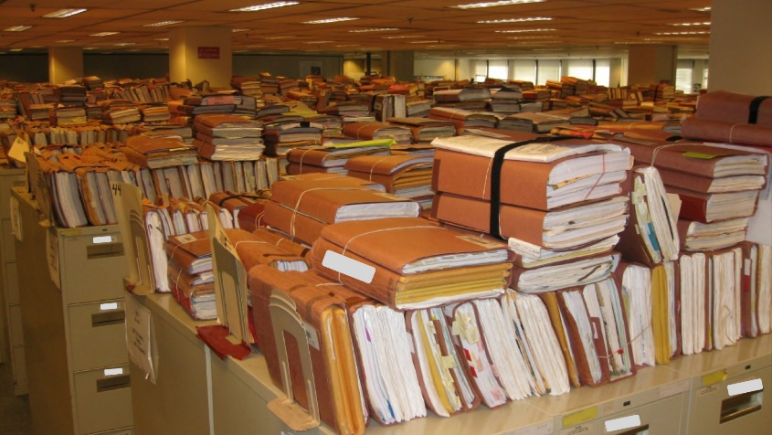
PROJECT CONTEXT
Problems that arises:
Inefficient storage
Prone to damage
Security
Time consuming
Availability

Slide 5


PROJECT CONTEXT
Problems that arises:
Inefficient storage
Prone to damage
Security
Time consuming
Availability

Slide 6
PROJECT CONTEXT
Problems that arises:
Inefficient storage
Prone to damage
Security
Time consuming
Availability

Slide 7



PROJECT CONTEXT
Problems that arises:
Inefficient storage
Prone to damage
Security
Time consuming
Availability

Slide 8

PROJECT CONTEXT
Problems that arises:
Inefficient storage
Prone to damage
Security
Time consuming
Availability

Slide 9
PROJECT CONTEXT
Problems that arises:
Inefficient storage
Prone to damage
Security
Time consuming
Availability

Slide 10


PROJECT CONTEXT
Problems that arises:
Inefficient storage
Prone to damage
Security
Time consuming
Availability

Slide 11

PROJECT CONTEXT
Problems that arises:
Inefficient storage
Prone to damage
Security
Time consuming
Availability

Slide 12



PROJECT CONTEXT
Problems that arises:
Inefficient storage
Prone to damage
Security
Time consuming
Availability

Slide 13
PROJECT CONTEXT
Problems that arises:
Inefficient storage
Prone to damage
Security
Time consuming
Availability

Slide 14

PROJECT CONTEXT
Problems that arises:
Inefficient storage
Prone to damage
Security
Time consuming
Availability

Slide 15

PROJECT CONTEXT
Problems that arises:
Inefficient storage
Prone to damage
Security
Time consuming
Availability

Slide 16

PROJECT CONTEXT
Problems that arises:
Inefficient storage
Prone to damage
Security
Time consuming
Availability

Slide 17

PROJECT CONTEXT
Problems that arises:
Inefficient storage
Prone to damage
Security
Time consuming
Availability

Slide 18
PROJECT CONTEXT
Problems that arises:
Inefficient storage
Prone to damage
Security
Time consuming
Availability

Slide 19

PROJECT CONTEXT
Problems that arises:
Inefficient storage
Prone to damage
Security
Time consuming
Availability

Slide 20

PROJECT CONTEXT
Problems that arises:
Inefficient storage
Prone to damage
Security
Time consuming
Availability

Slide 21
PROJECT CONTEXT
Existing Systems for storing grades

Slide 22
PROJECT CONTEXT
Existing Systems for storing grades
Uses Excel

Slide 23

PROJECT CONTEXT
Existing Systems for storing grades
Uses Excel

Slide 24
PROJECT CONTEXT
Existing Systems for storing grades
Uses Excel
BEST SOLUTION

Slide 25
PROJECT CONTEXT
CHALLENGE:
Accurate
Safe
Available at all times

Slide 26
PROJECT CONTEXT
SYSTEM THAT INTEGRATES AND ARCHIVES ALL THE STUDENTS’ GRADES
PROPOSED PROJECT
ONE SYSTEM

Slide 27
PURPOSE AND DESCRIPTION
Develop a System that:
Integrates and archives all the students’ grades
Provides a secure storage
Reduces the process time of recording and transferring of grades
Avoids the usage of paper

Slide 28

PURPOSE AND DESCRIPTION
Provides Public Schools:
Safe
Secured
Easy access

Slide 29

OBJECTIVES
Lighten the grade recording process
Hasten the process of transmitting records
Lessen the tedious manual process
Secure student’s grade

Slide 30

OBJECTIVES
Lighten the grade recording process
Hasten the process of transmitting records
Lessen the tedious manual process
Secure student’s grade

Slide 31

OBJECTIVES
Lighten the grade recording process
Hasten the process of transmitting records
Lessen the tedious manual process
Secure student’s grade

Slide 32
OBJECTIVES
Lighten the grade recording process
Hasten the process of transmitting records
Lessen the tedious manual process
Secure student’s grade

Slide 33
SCOPE AND LIMITATIONS
Grade 1 - Grade 10
Public Schools only

Slide 34
RELATED LITERATURE

Slide 35
Document Management System (DMS)
Faster document retrieval
Centralization of archiving
Better decision making process
Better distribution of work
Better electronic documents handling

Slide 36
Document Management System (DMS)
Not timing consuming
Less space for archiving
Reduces labor
Easy access to files
Eliminates lost and misplaced files.

Slide 37
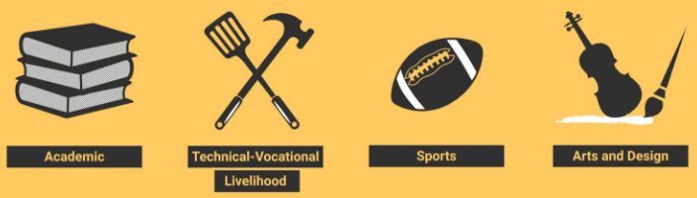
K-12 Education System
DepEd
Kindergarten to Grade 12
Tracks

Slide 38

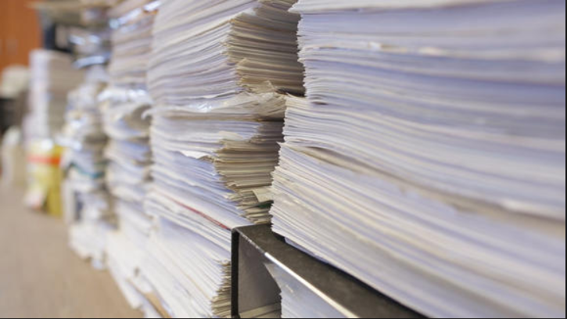
Using Spreadsheets to Keep Track of Students' Grades

Slide 39

Learner Information System (LIS)
Provide a standardized registration
Track learner progress / performance
Provide learner information
Enhance management of learner records.

Slide 40

Electronic Class Record (ECR)
Convenient
Ensures accuracy
Accessible

Slide 41
TECHNICAL BACKGROUND

Slide 42

Technical Background

Slide 43



Technical Background

Slide 44
DESIGN AND METHODOLOGY

Slide 45



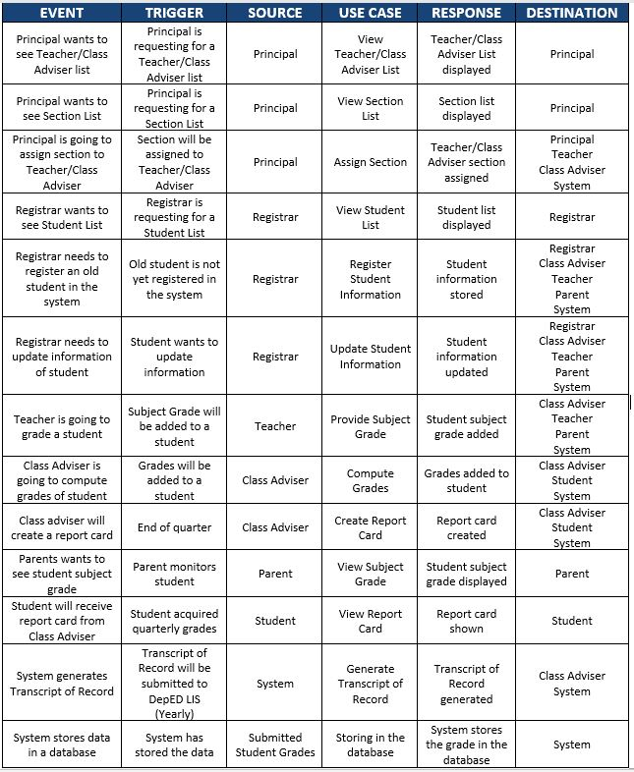


Events Table
Requirements Analysis

Slide 46

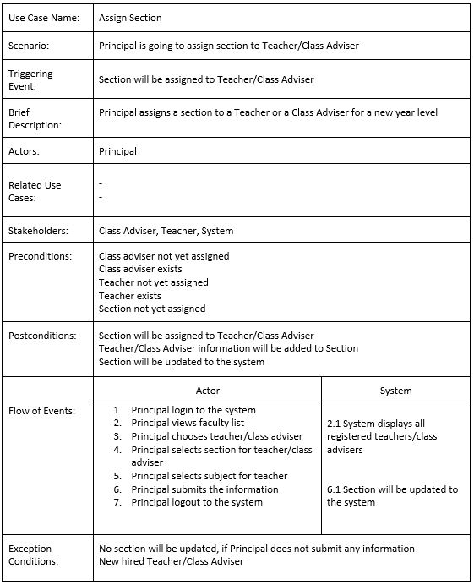
Assign Section
Requirements Documentation

Slide 47
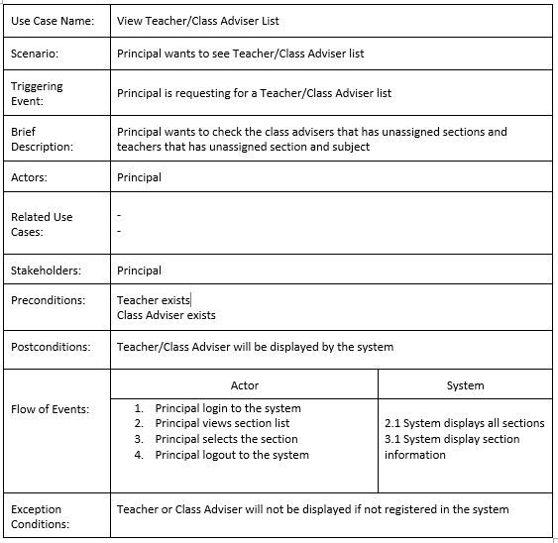
View Teacher-Class Adviser List
Requirements Documentation

Slide 48
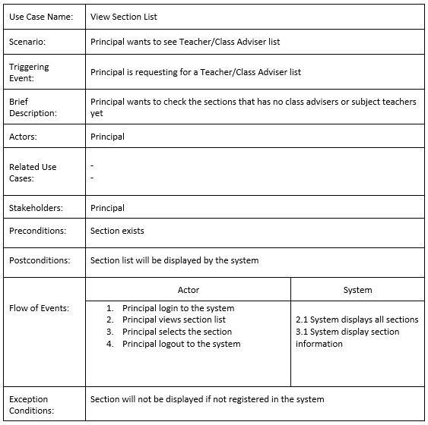
View Section List
Requirements Documentation

Slide 49
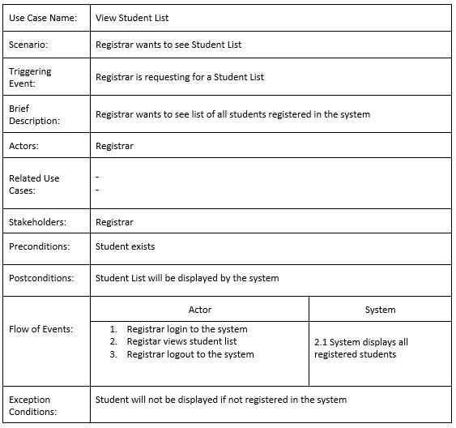
View Student List
Requirements Documentation

Slide 50
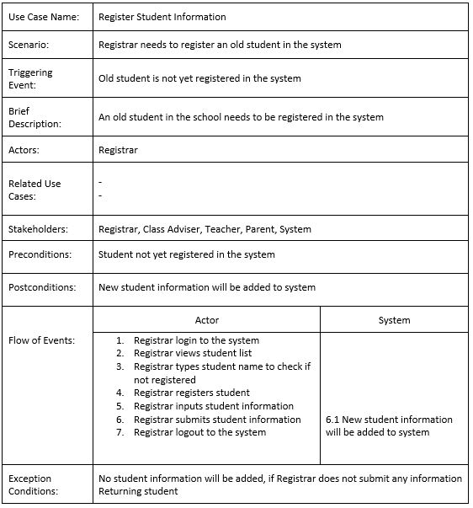
Register Student Information
Requirements Documentation

Slide 51
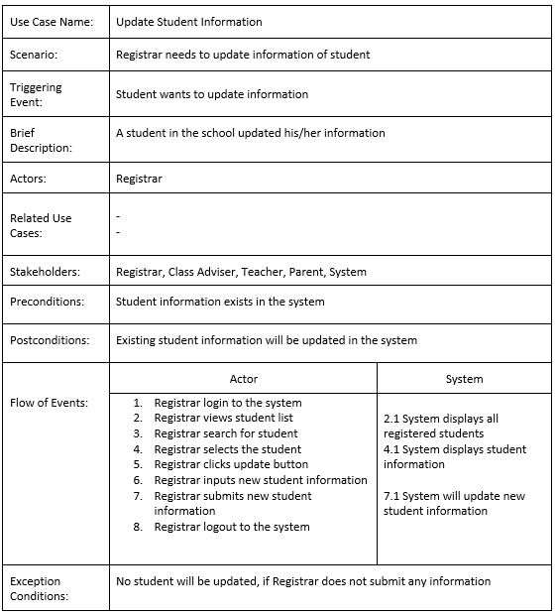
Update Student Information
Requirements Documentation

Slide 52
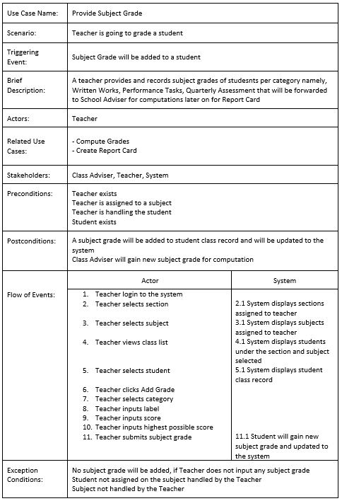
Provide Subject Grade
Requirements Documentation

Slide 53
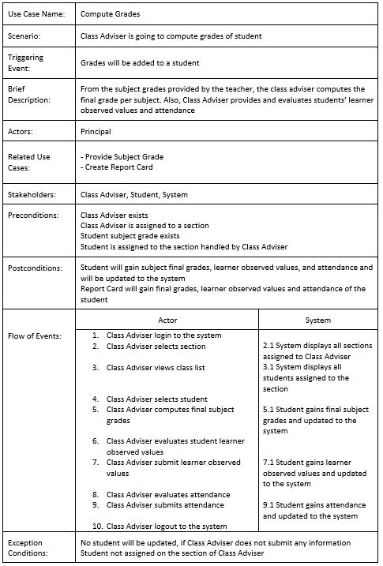
Compute Grades
Requirements Documentation

Slide 54
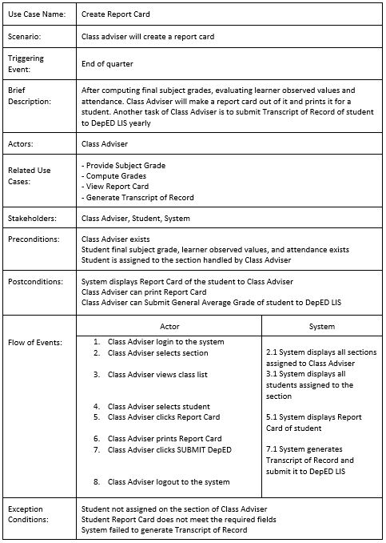
Create Report Card
Requirements Documentation

Slide 55
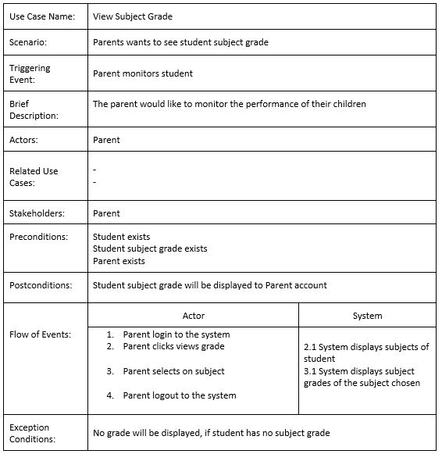
View Subject Grade
Requirements Documentation

Slide 56
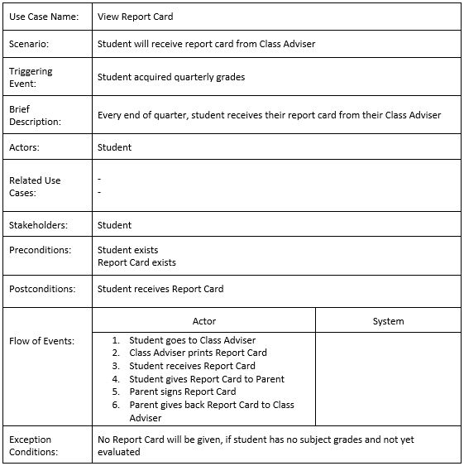
View Report Card
Requirements Documentation

Slide 57
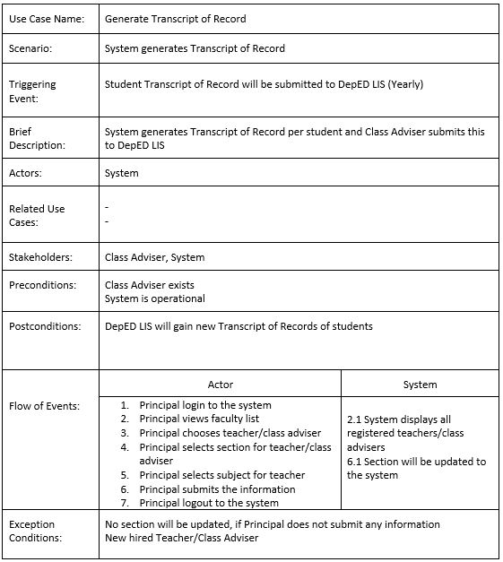
Generate Transcript of Record
Requirements Documentation

Slide 58
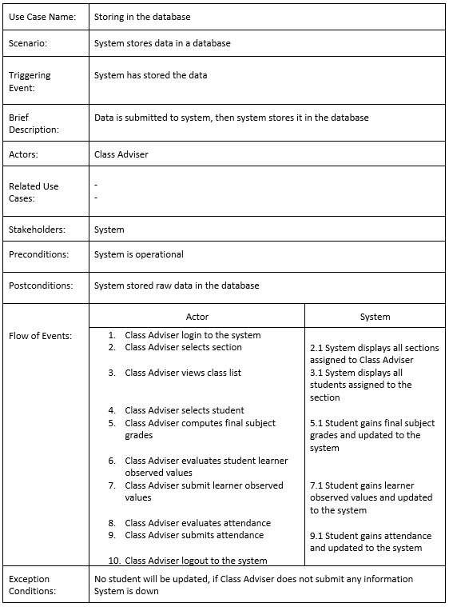
Storing in the Database
Requirements Documentation

Slide 59
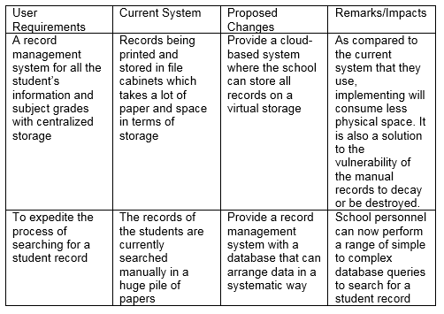
Gap Analysis
Requirements Documentation

Slide 60
Results and Discussion

Slide 61
UML Diagrams

Slide 62
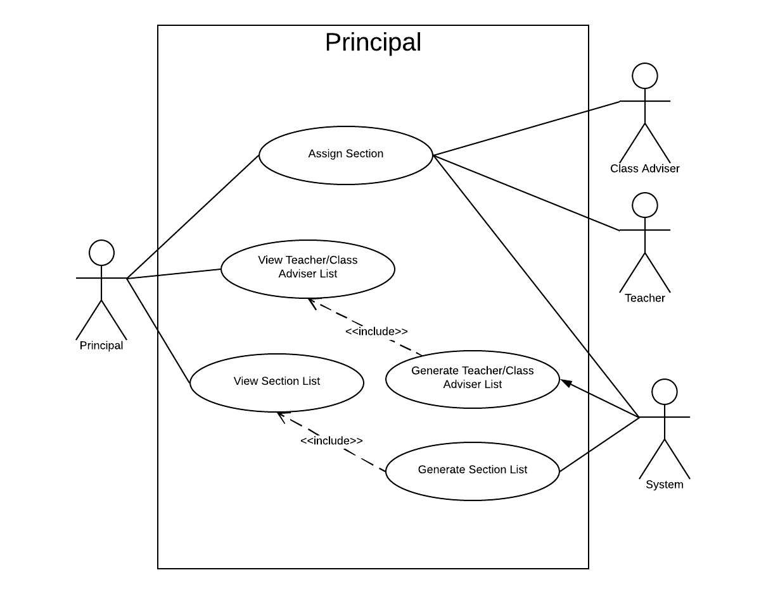
Use Case Diagram - Principal

Slide 63
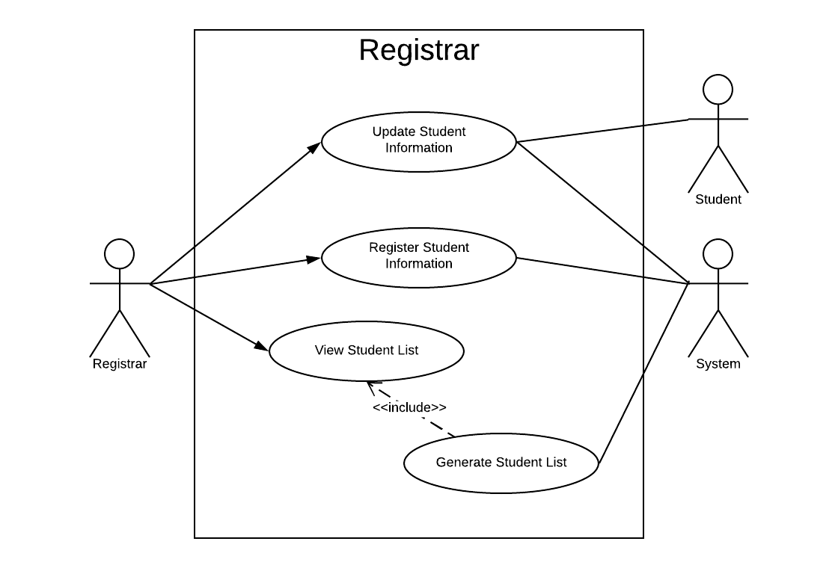
Use Case Diagram - Registrar

Slide 64
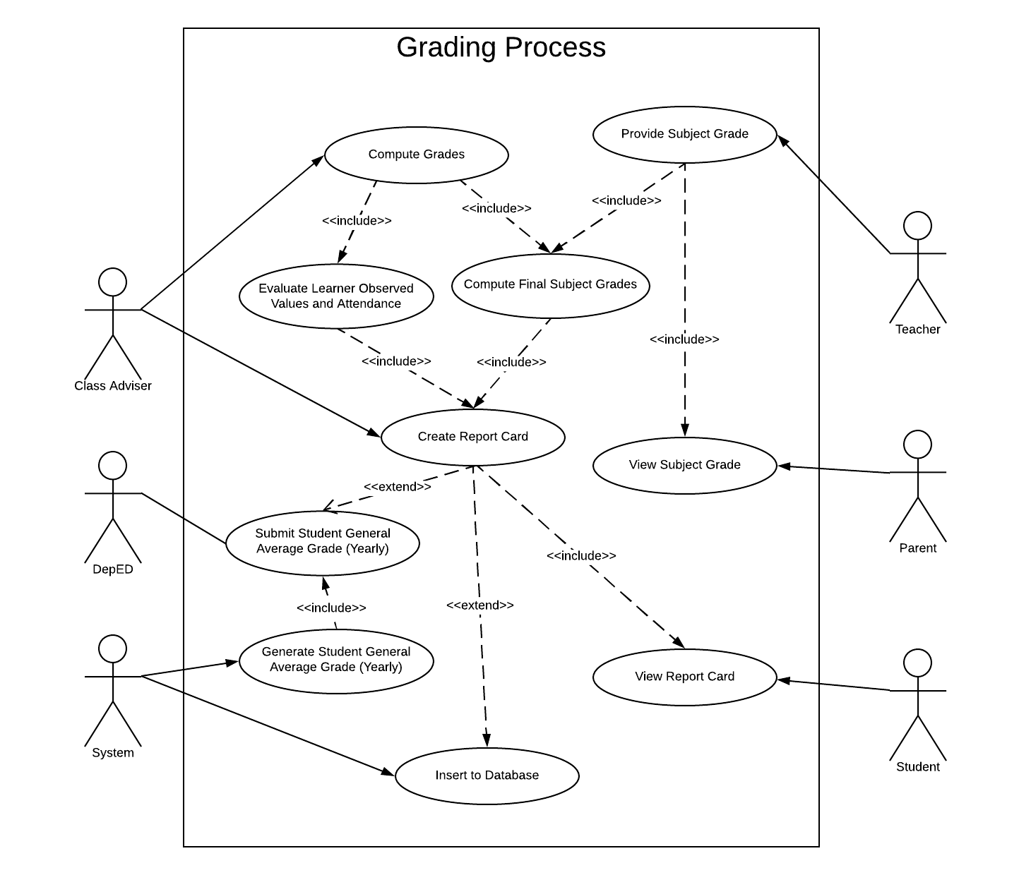
Use Case Diagram – Grading Process

Slide 65
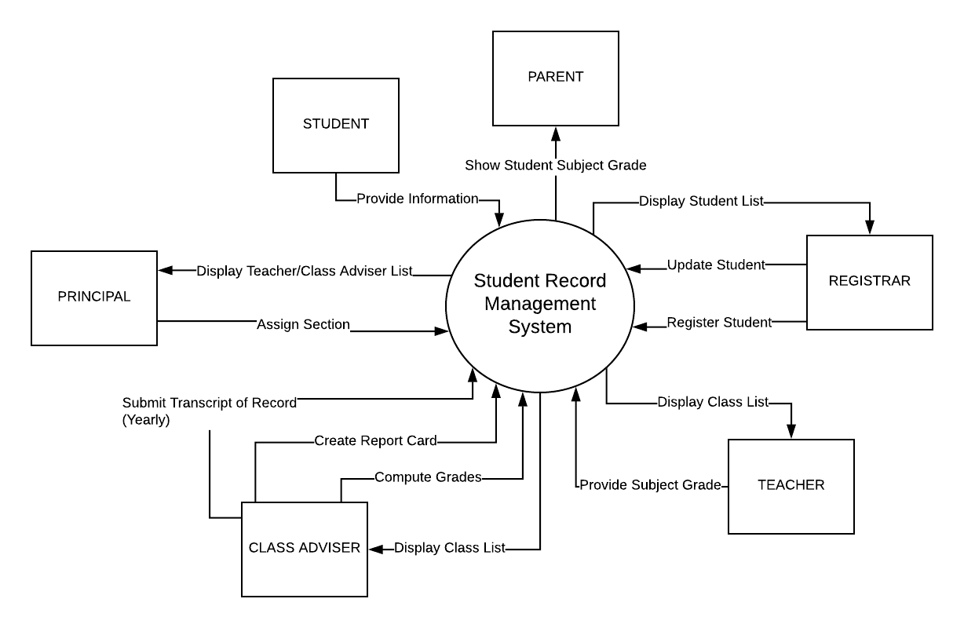
Context Level Diagram

Slide 66
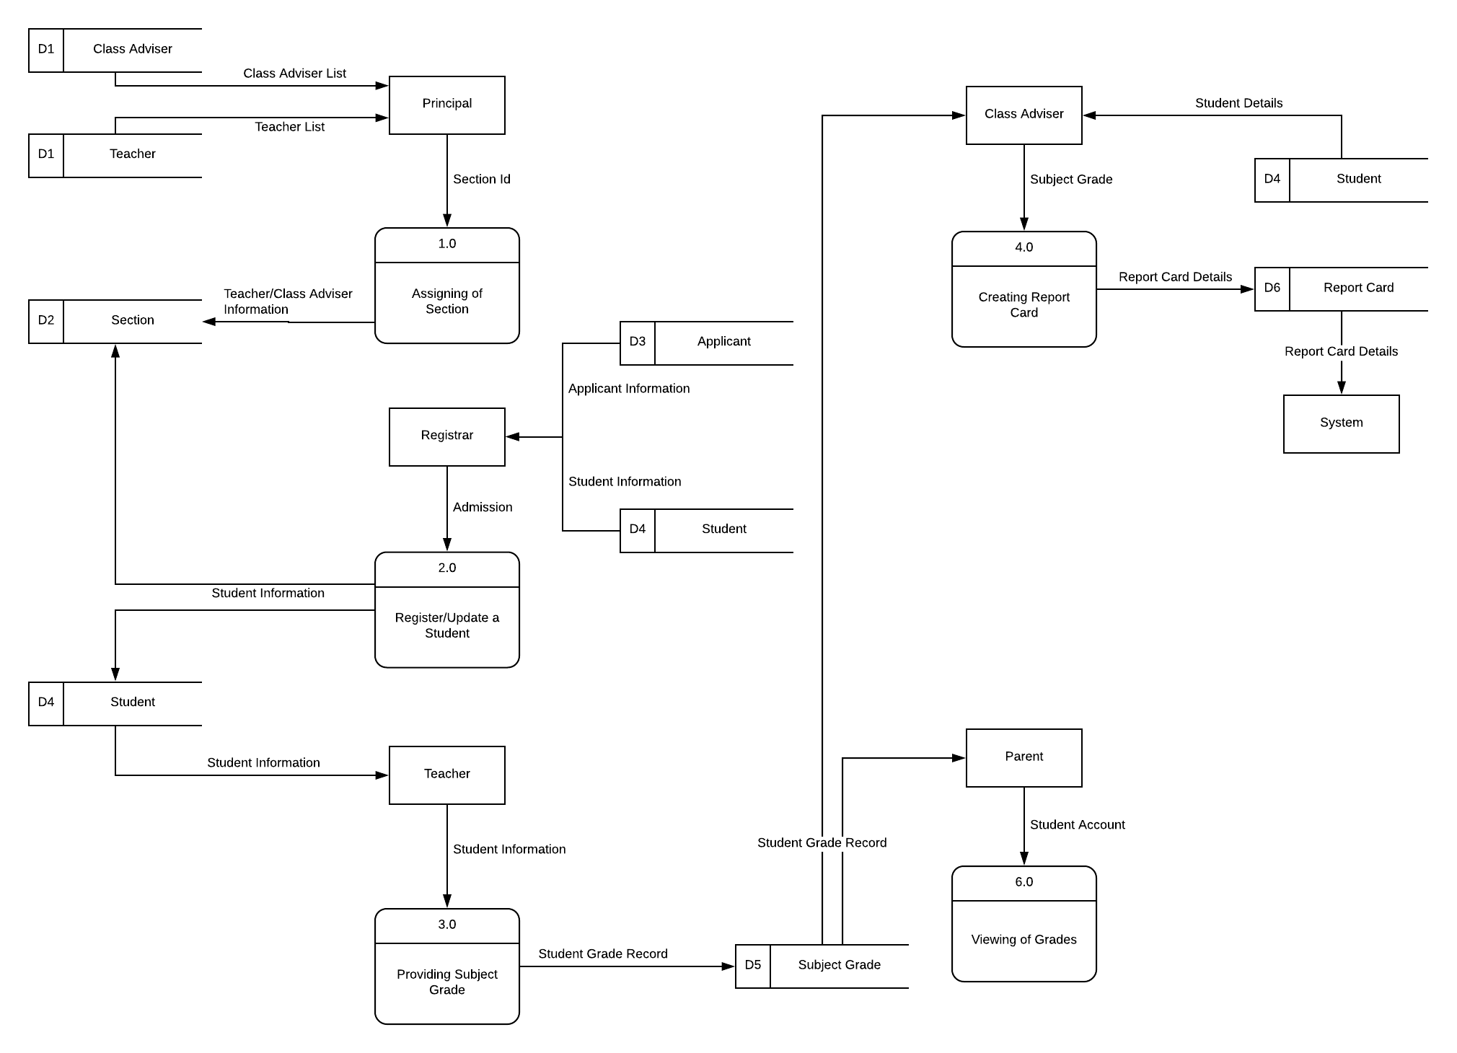
Data Flow Diagram Level 0

Slide 67
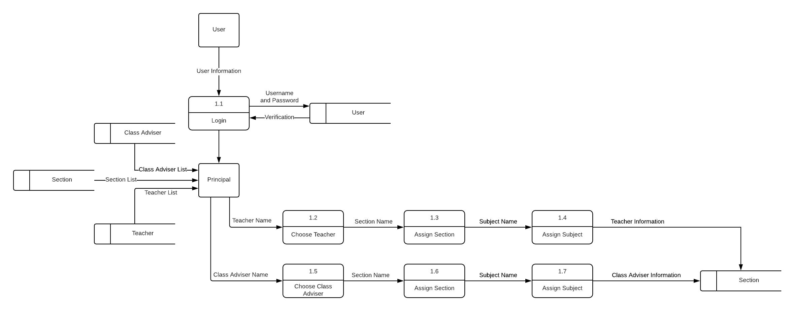
Data Flow Diagram Level 1 - Principal

Slide 68
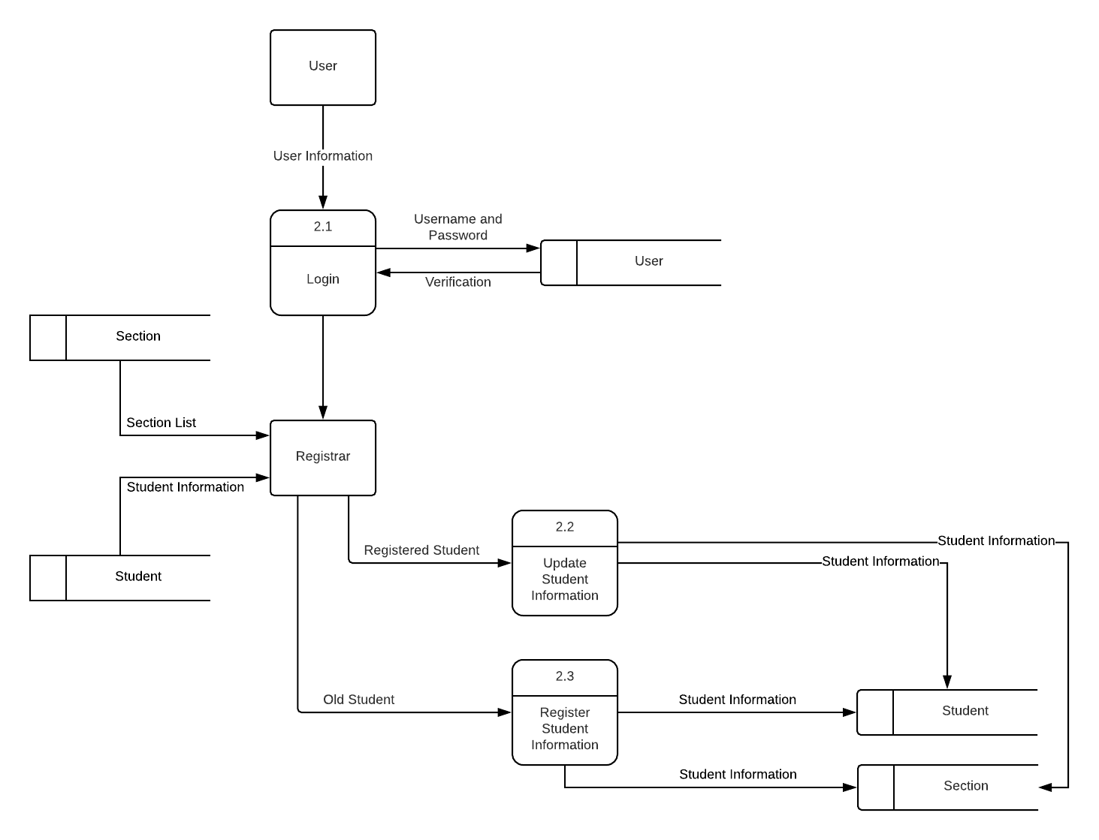
Data Flow Diagram Level 1 - Registrar

Slide 69
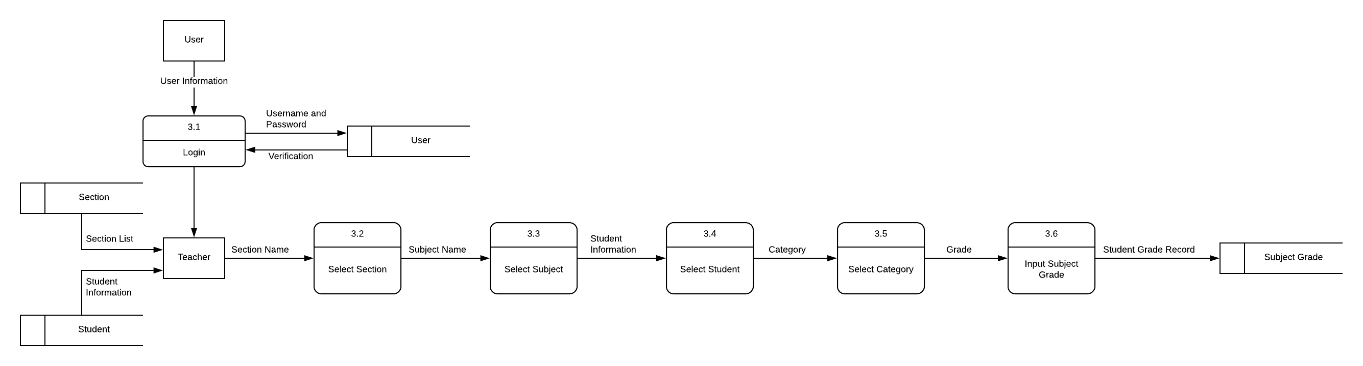
Data Flow Diagram Level 1 - Teacher

Slide 70
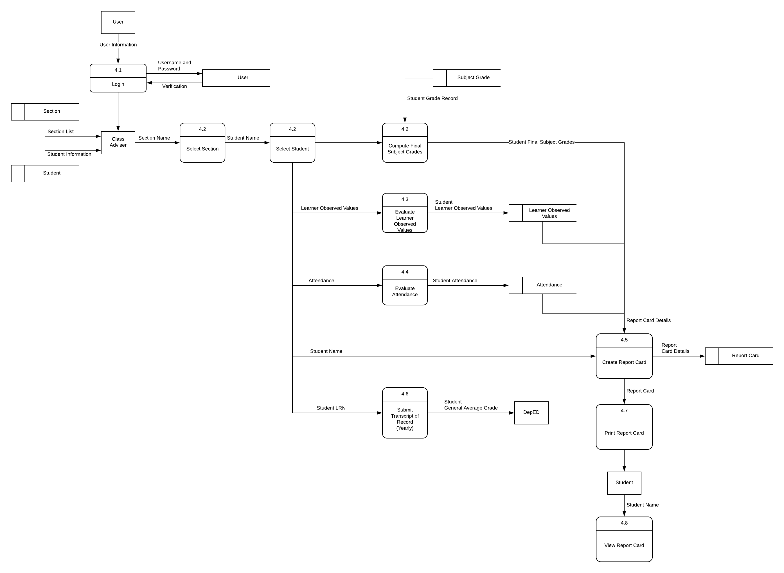
Data Flow Diagram Level 1 – Class Adviser

Slide 71
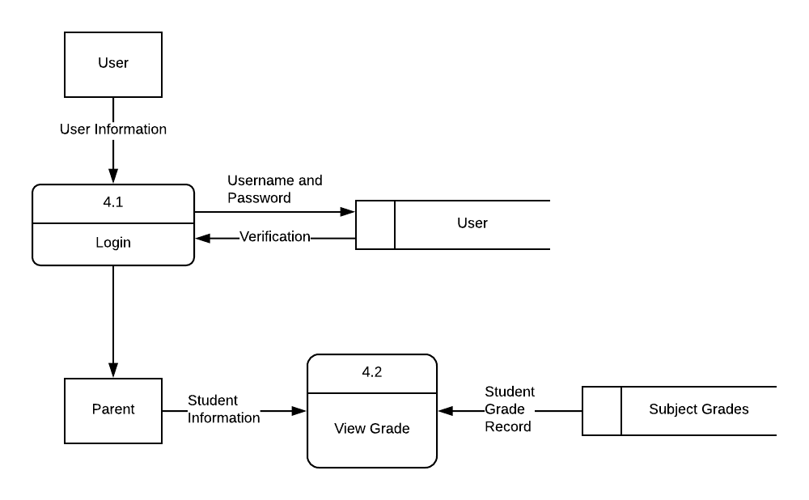
Data Flow Diagram Level 1 – Parent

Slide 72
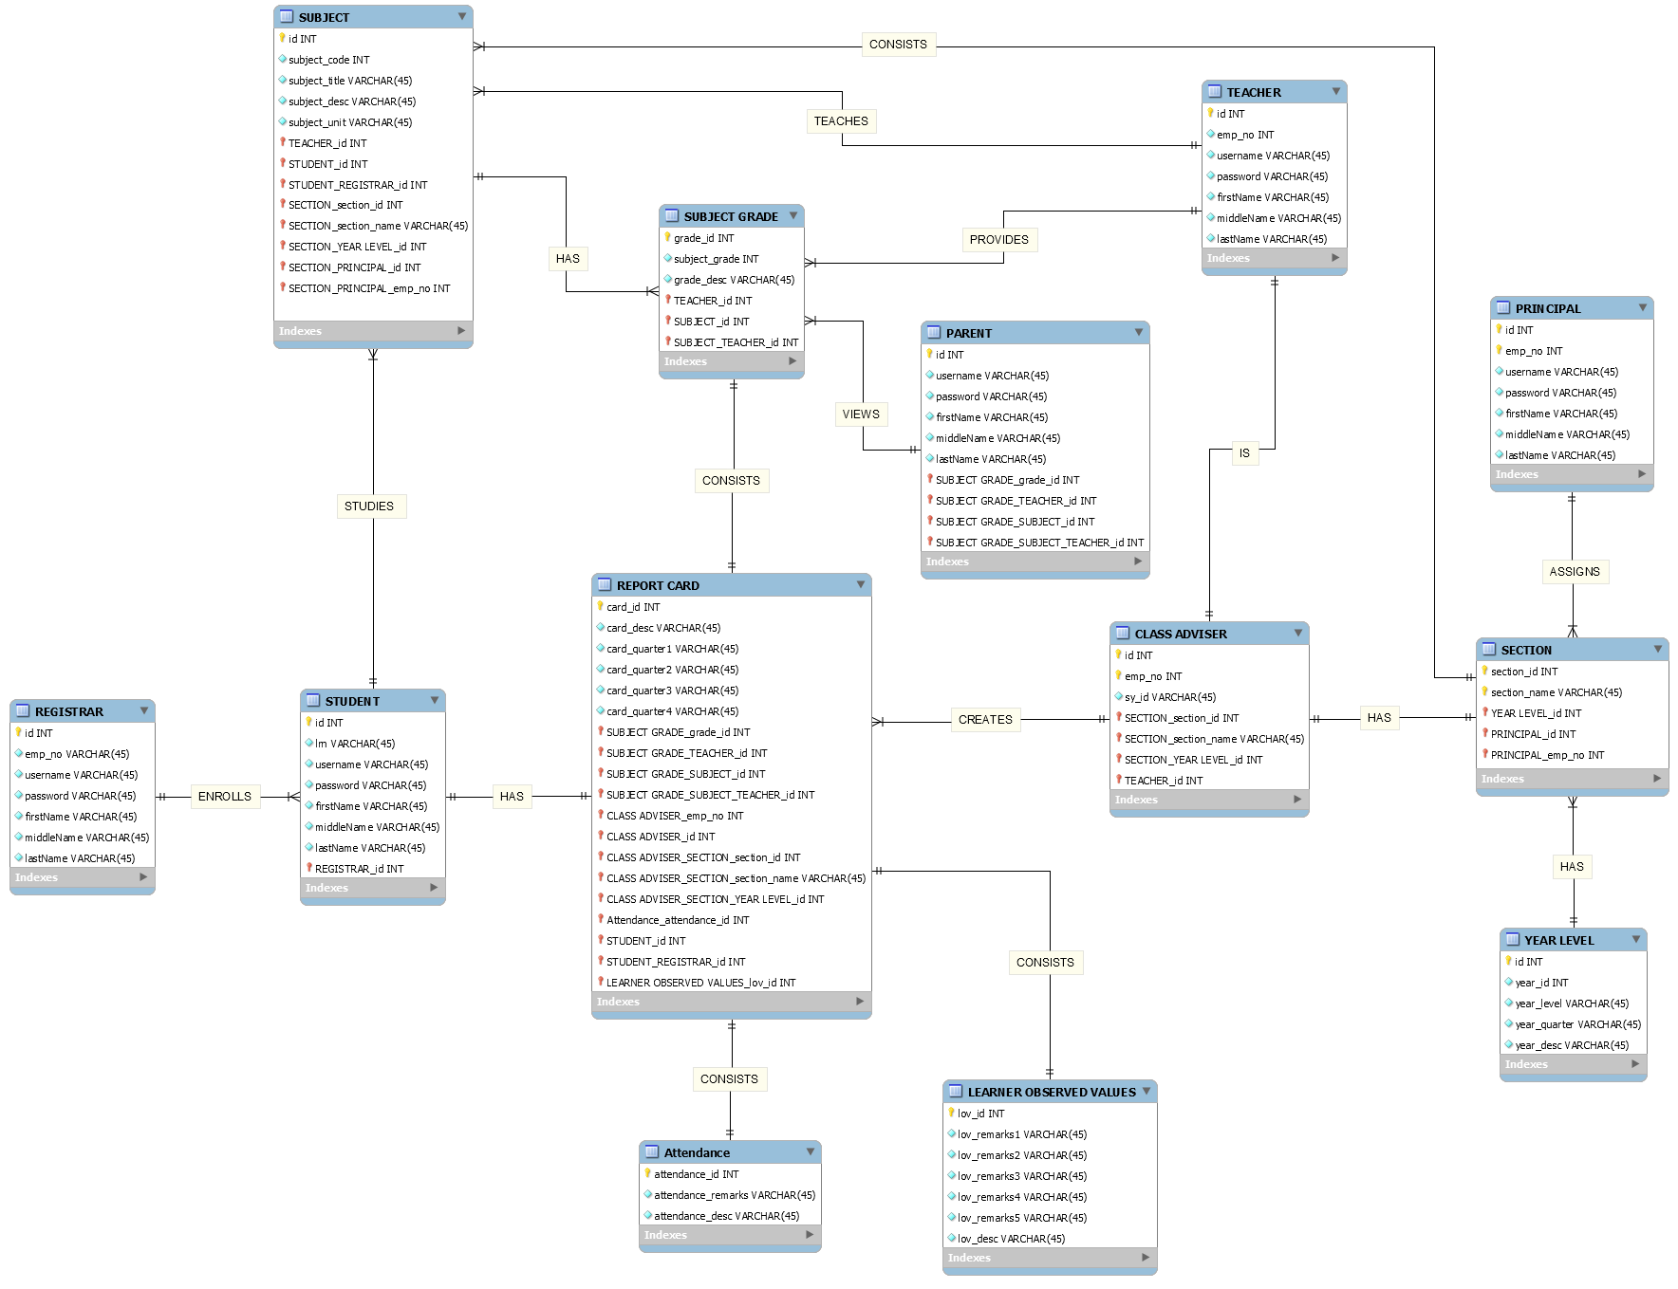
Entity Relationship Diagram

Slide 73
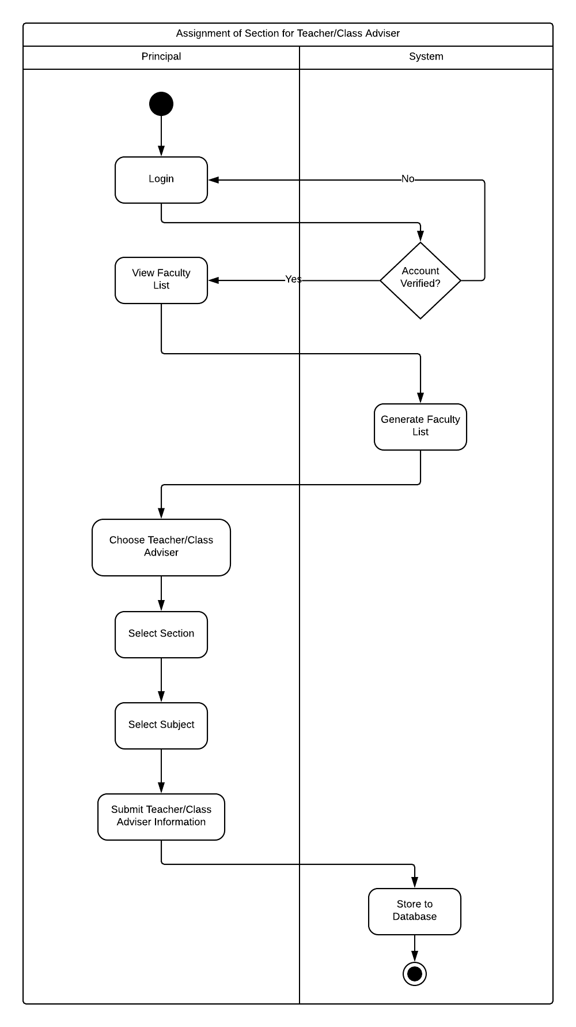
Assignment of Section – Activity Diagram

Slide 74
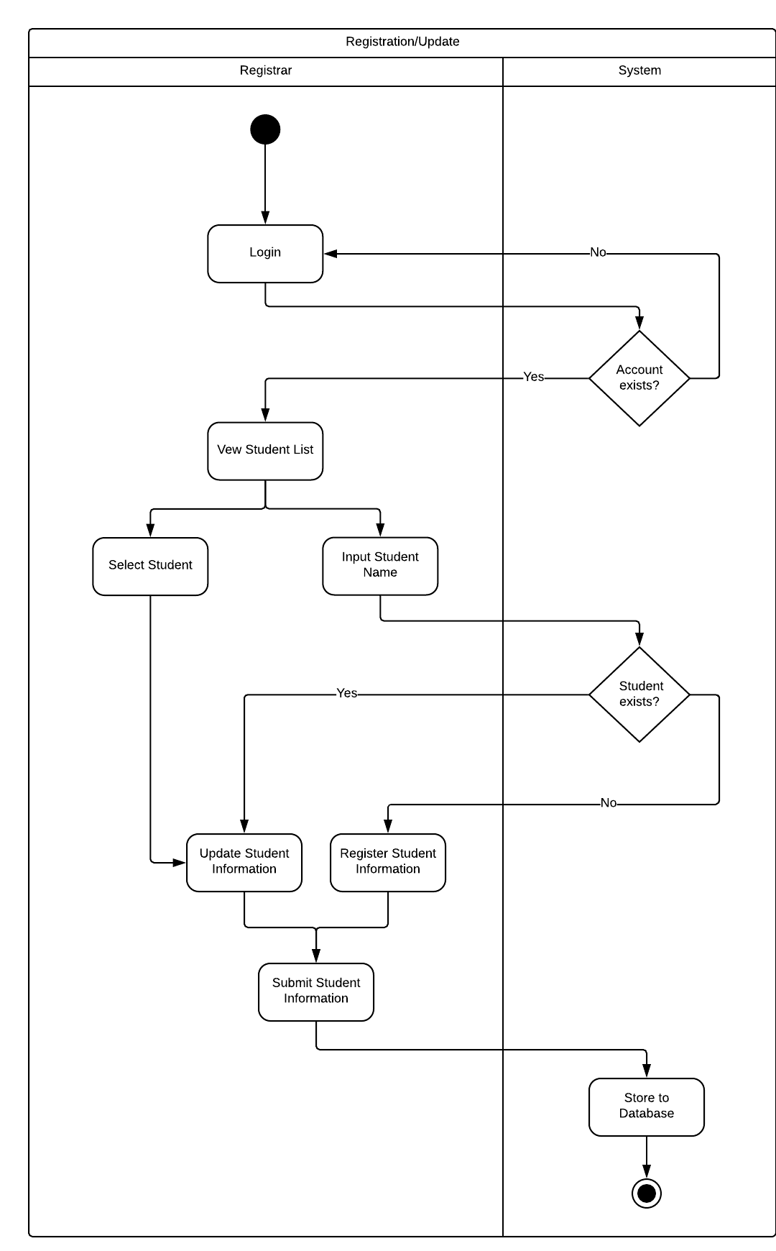
Register-Update of Student – Activity Diagram

Slide 75
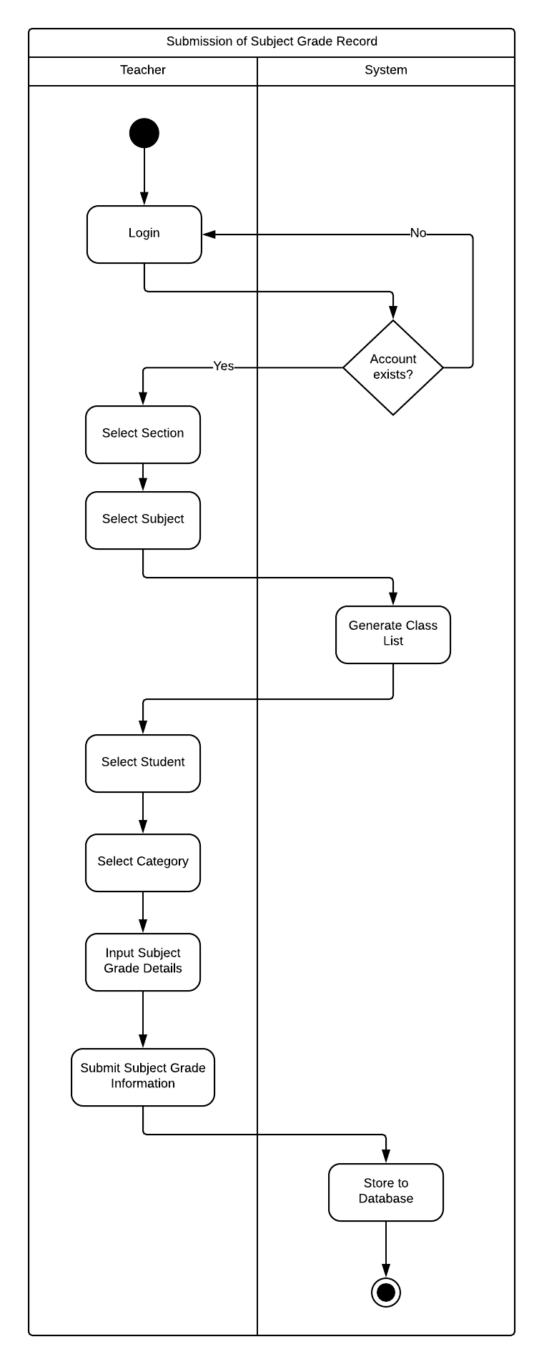
Submission of Subject Grade Record– Activity Diagram

Slide 76
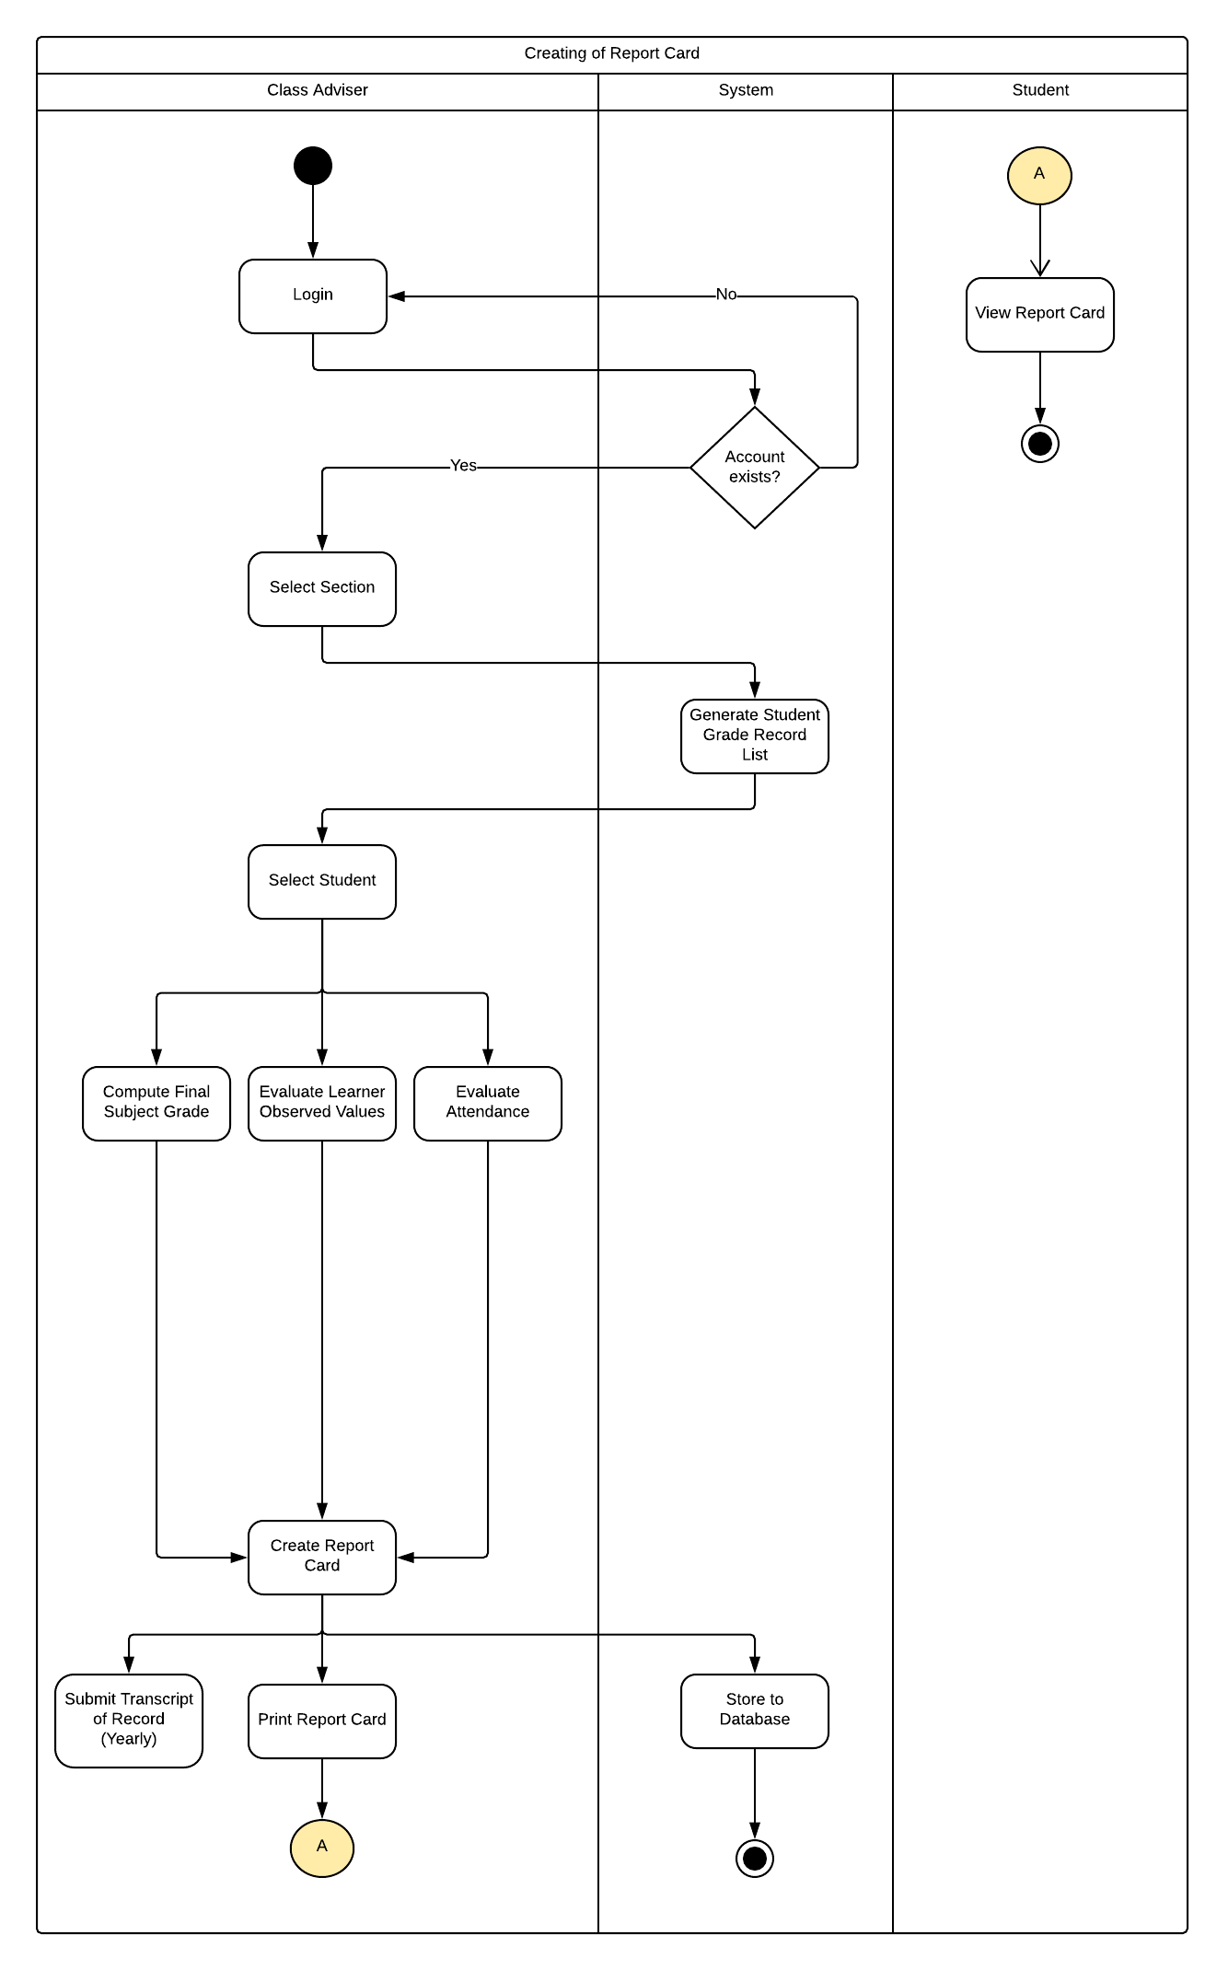
Creating of Report Card– Activity Diagram

Slide 77
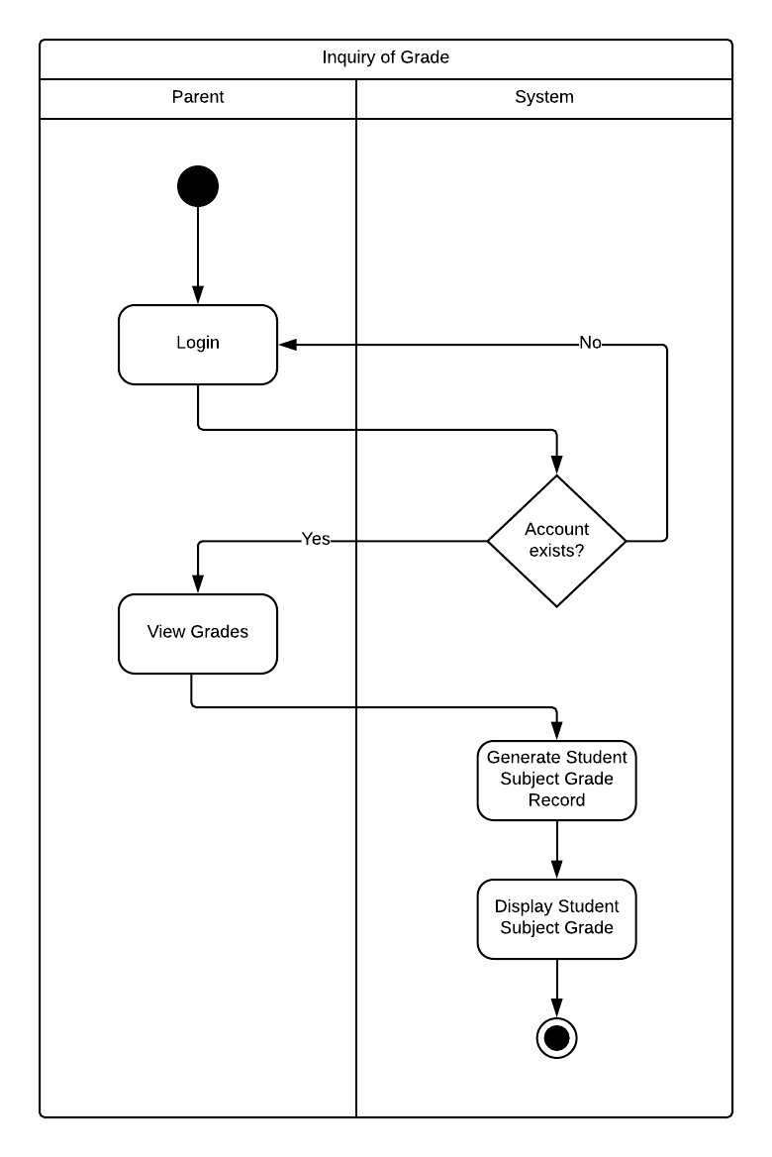
Inquiry of Grade – Activity Diagram

Slide 78
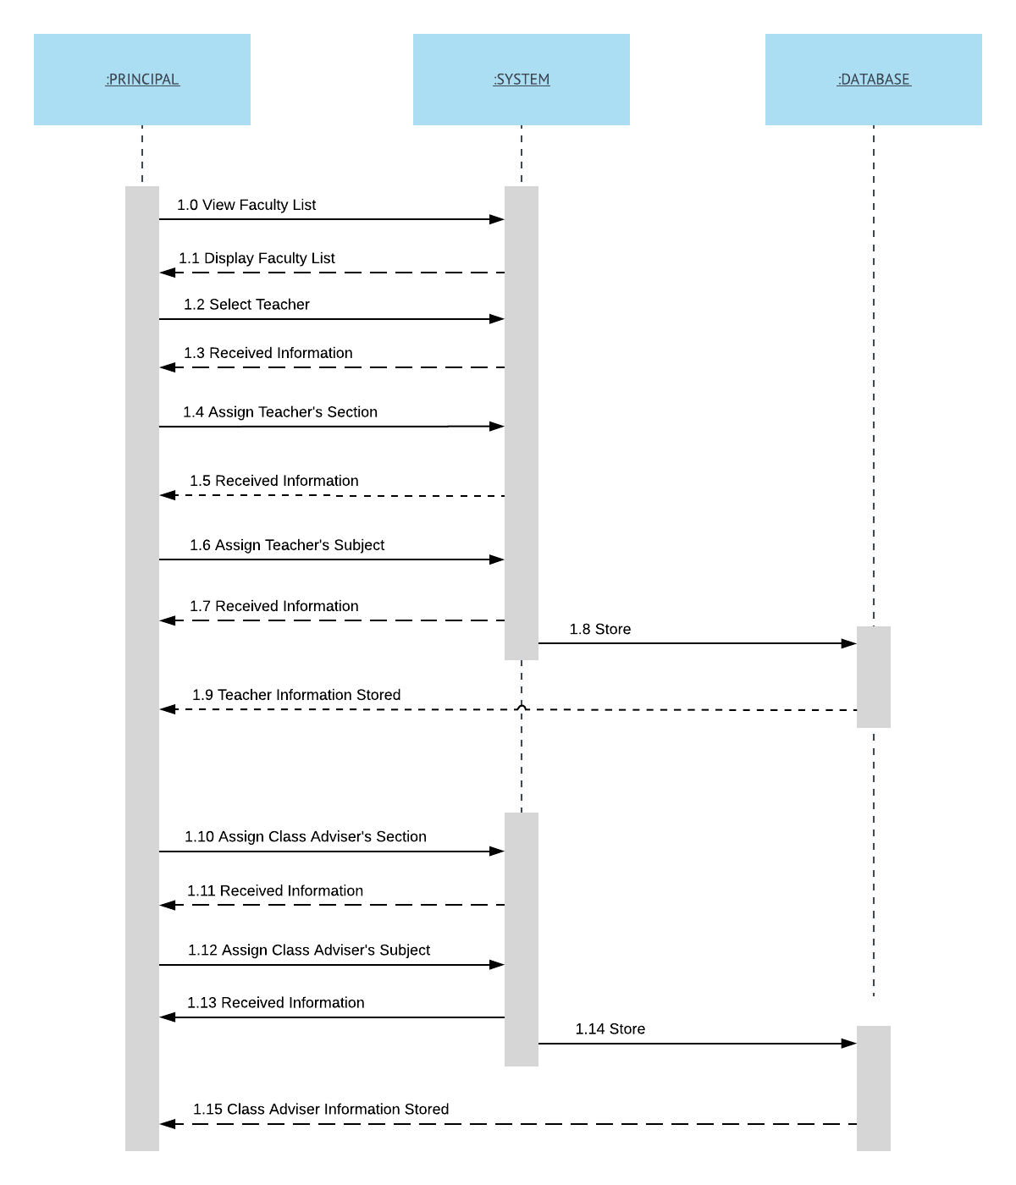
Principal - System Sequence Diagram

Slide 79
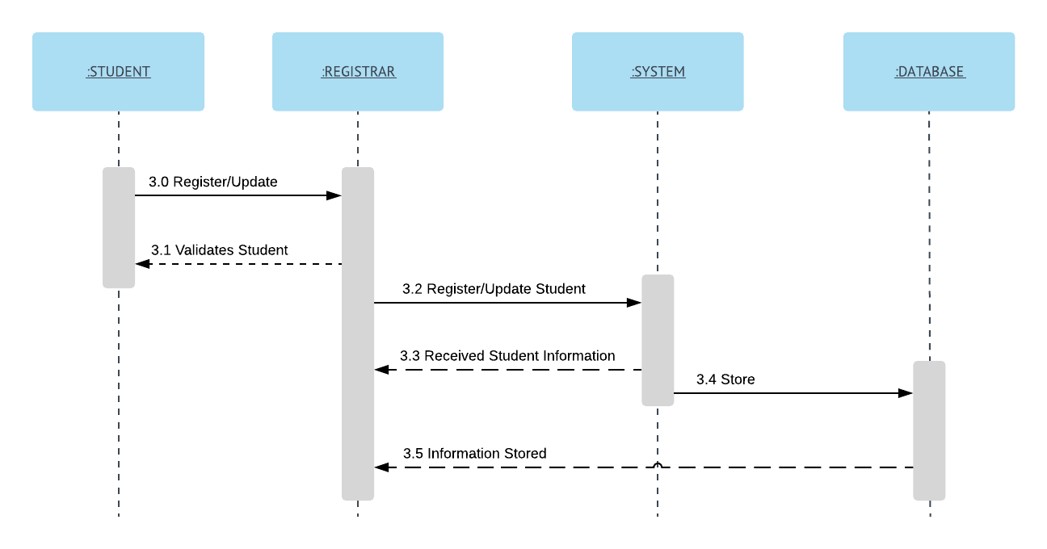
Registrar - System Sequence Diagram

Slide 80
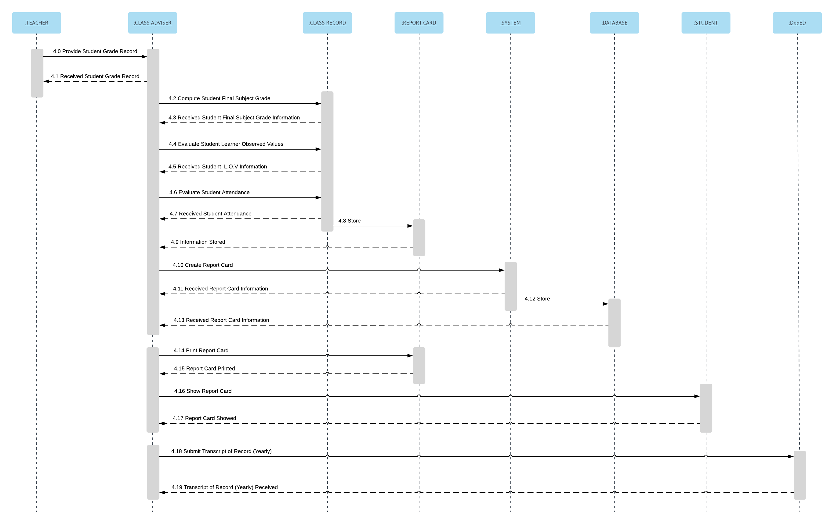
Teacher-Class Adviser - System Sequence Diagram

Slide 81
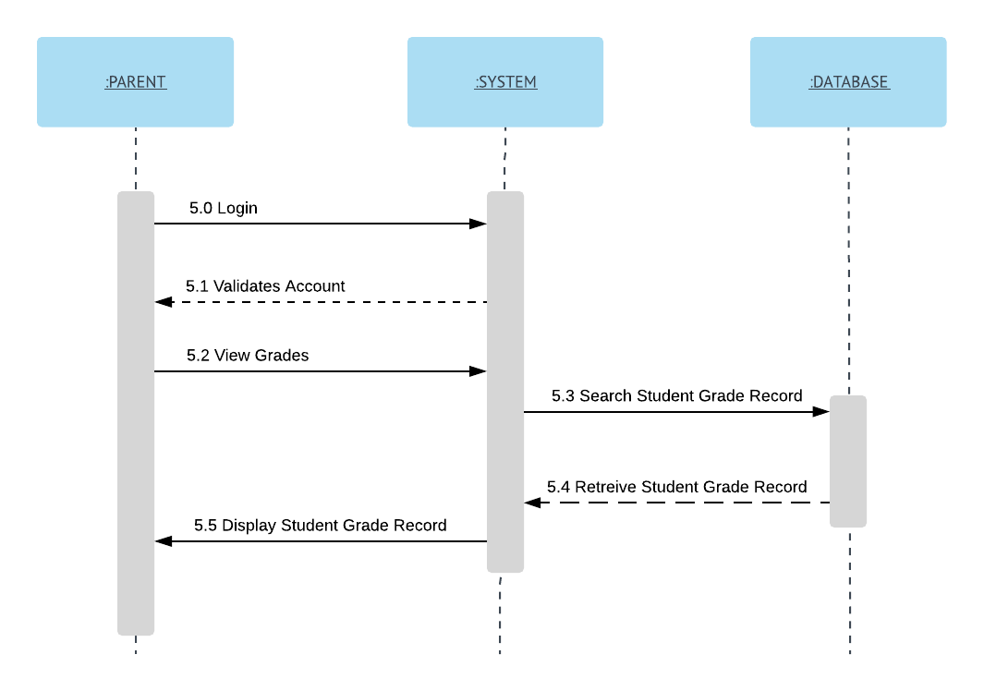
Parent - System Sequence Diagram

Slide 82
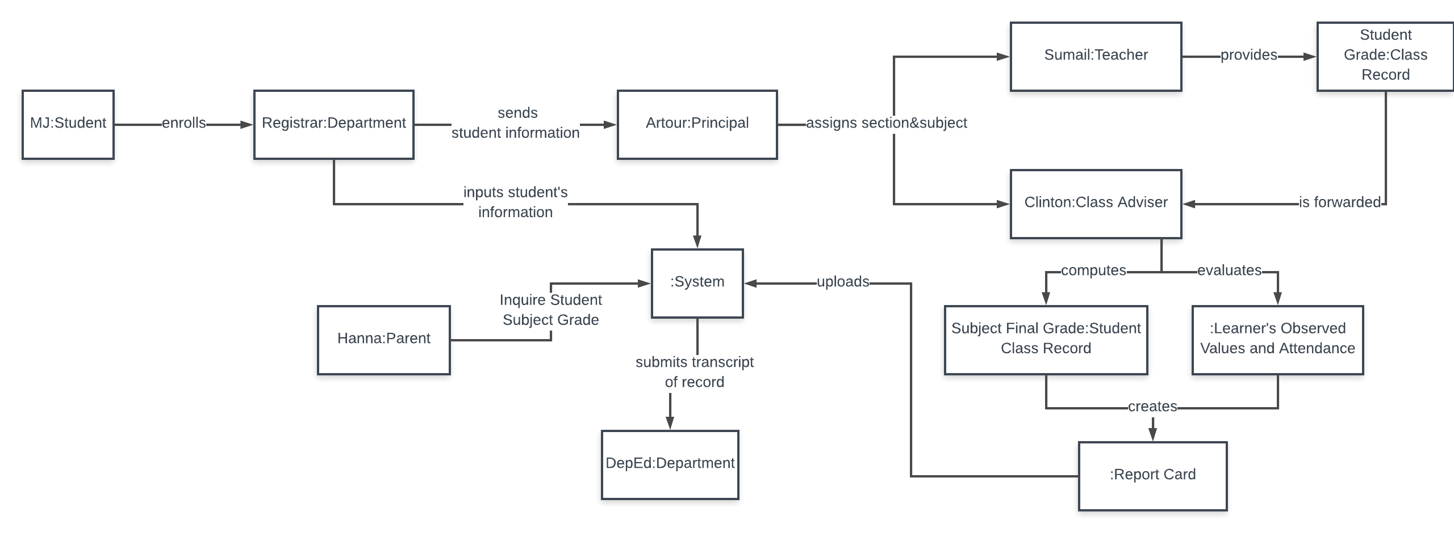
Object Diagram

Slide 83
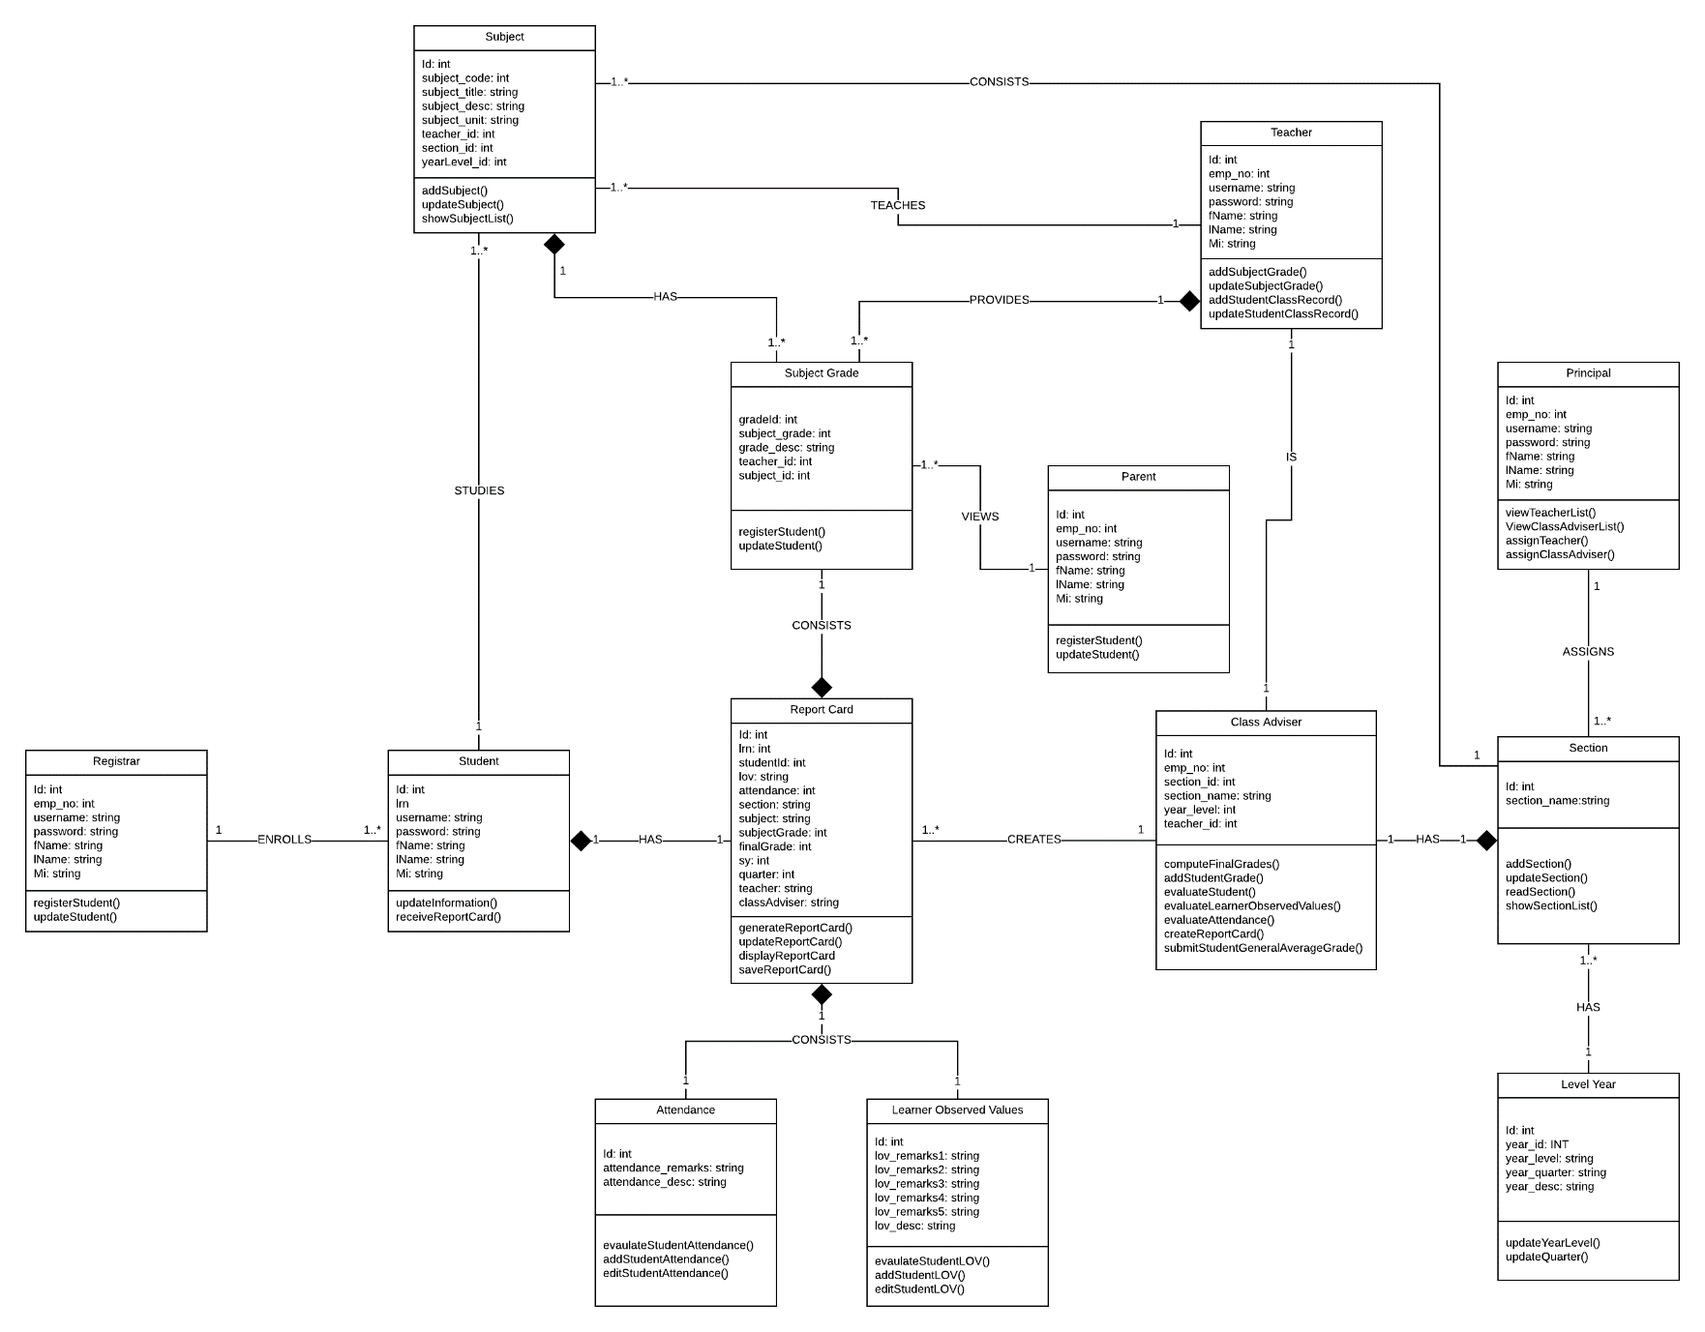
Class Diagram

Slide 84
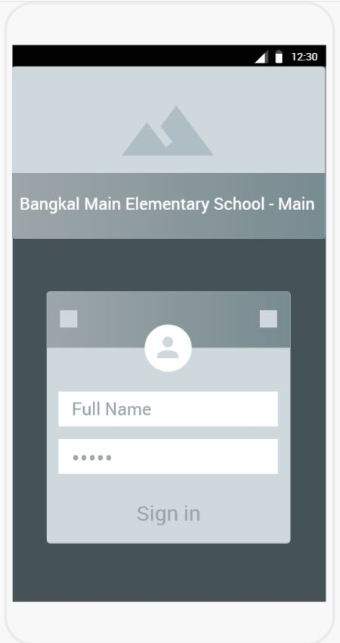
Login Screen
Prototype Wireframes

Slide 85
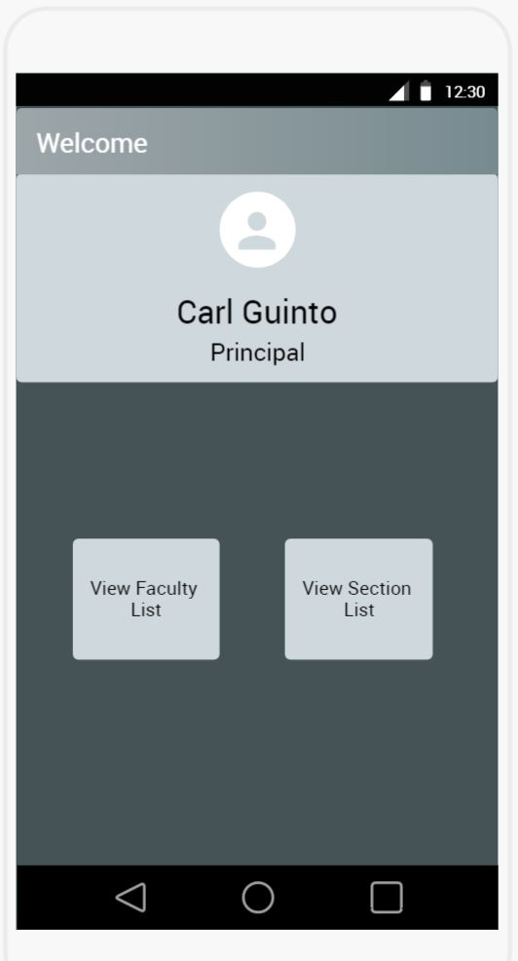
Principal
Prototype Wireframes

Slide 86
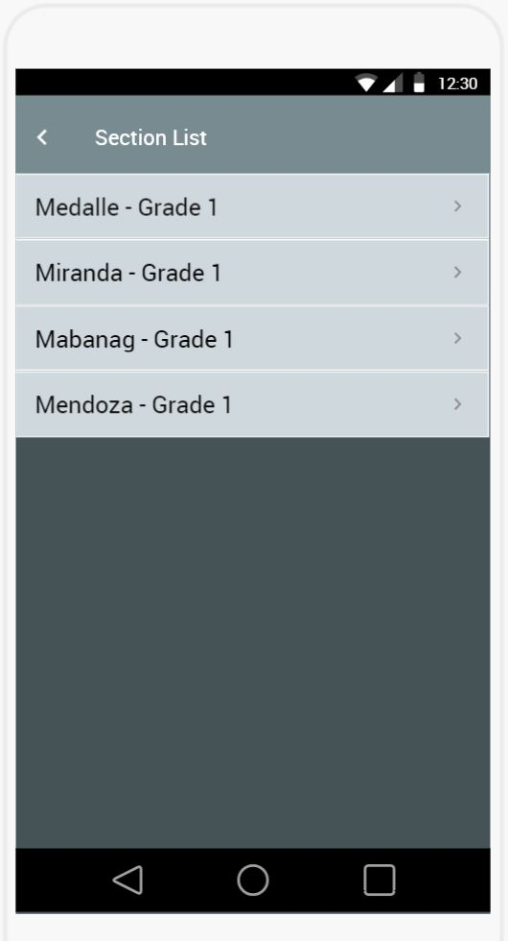
Principal
Prototype Wireframes

Slide 87
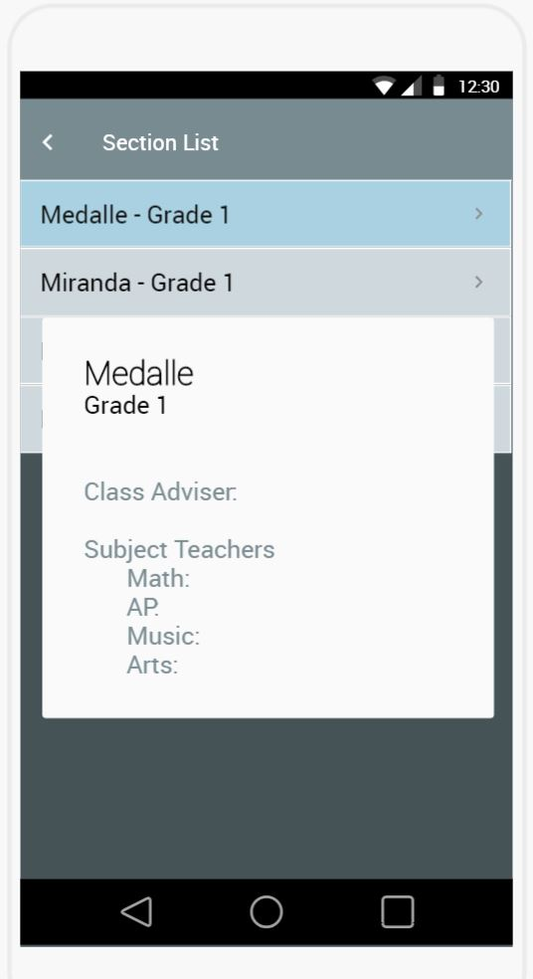
Principal
Prototype Wireframes

Slide 88
Principal
Prototype Wireframes

Slide 89
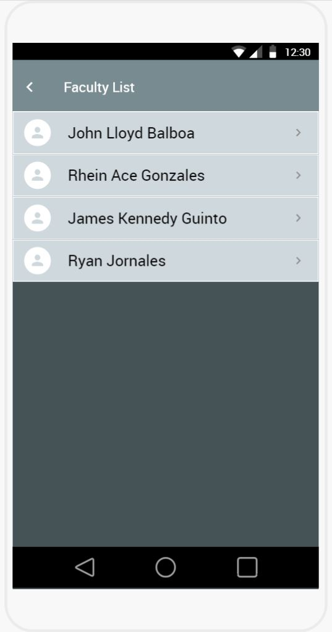
Principal
Prototype Wireframes

Slide 90
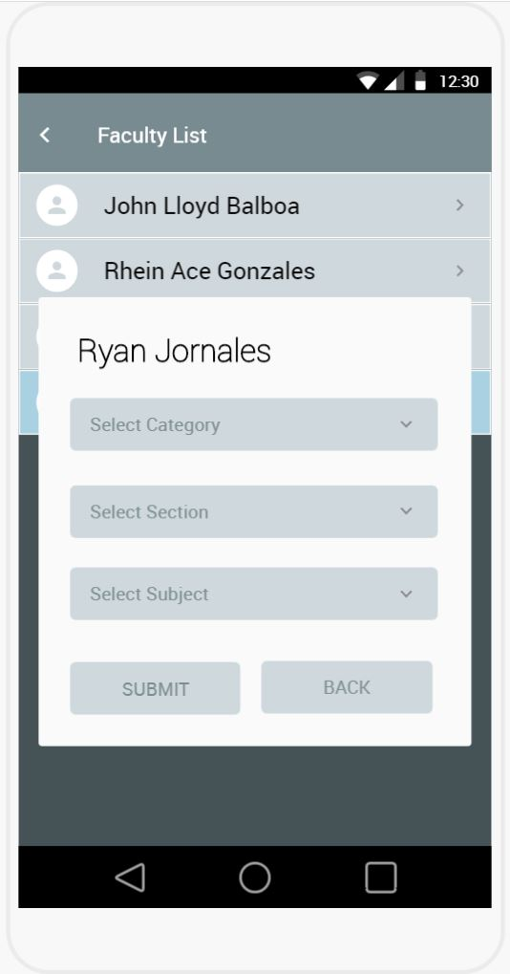
Principal
Prototype Wireframes

Slide 91
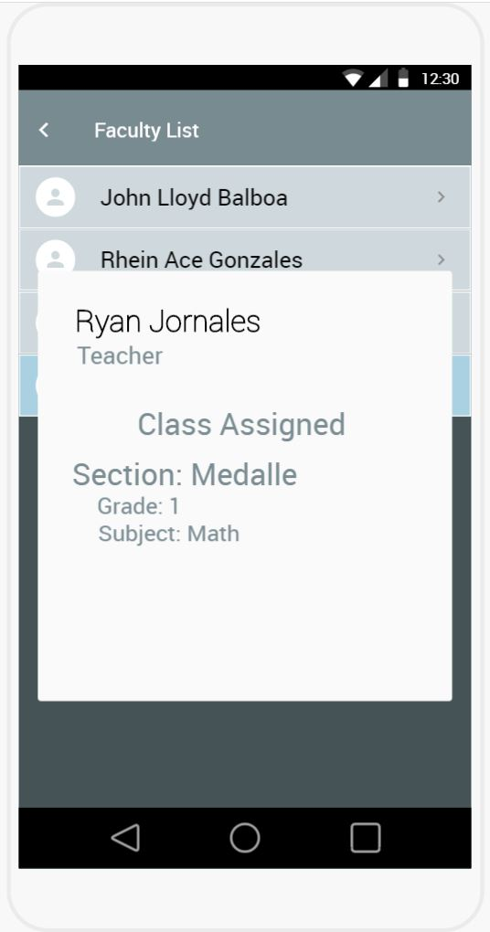
Principal
Prototype Wireframes

Slide 92
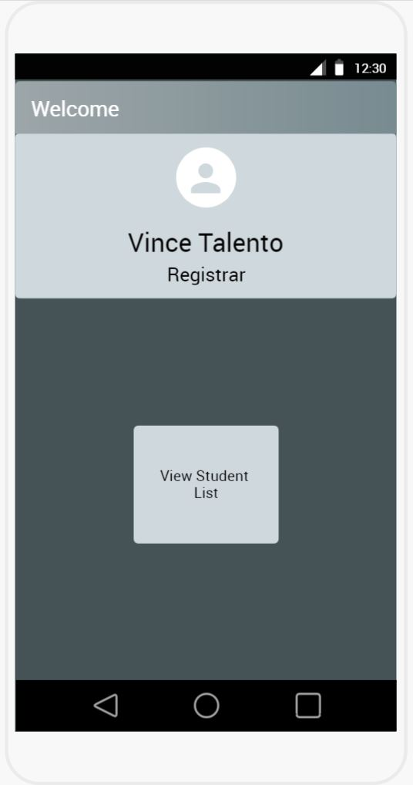
Registrar
Prototype Wireframes

Slide 93
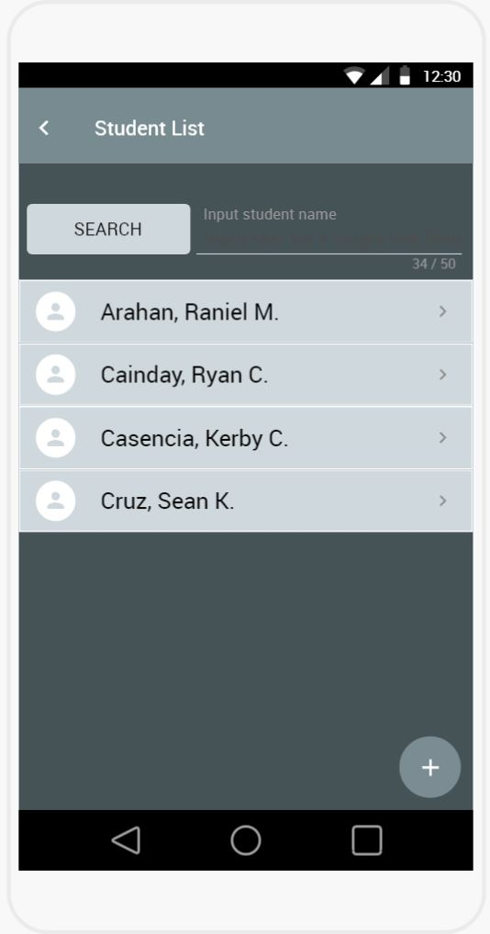
Registrar
Prototype Wireframes

Slide 94
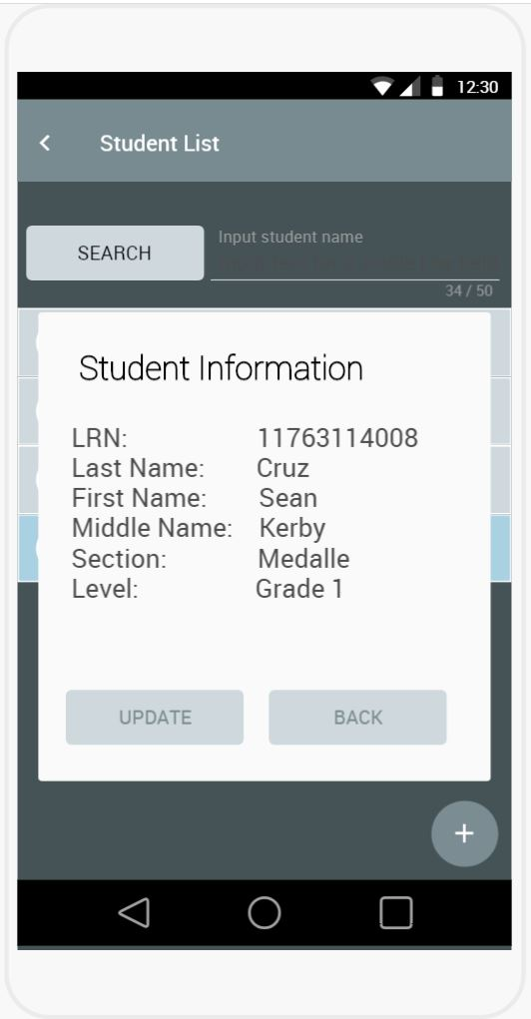
Registrar
Prototype Wireframes

Slide 95

Registrar
Prototype Wireframes

Slide 96
Registrar
Prototype Wireframes

Slide 97

Registrar
Prototype Wireframes

Slide 98

Registrar
Prototype Wireframes

Slide 99

Teacher
Prototype Wireframes

Slide 100

Teacher
Prototype Wireframes

Slide 101

Teacher
Prototype Wireframes

Slide 102

Teacher
Prototype Wireframes

Slide 103

Teacher
Prototype Wireframes

Slide 104

Class Adviser
Prototype Wireframes

Slide 105

Class Adviser
Prototype Wireframes

Slide 106

Class Adviser
Prototype Wireframes

Slide 107

Class Adviser
Prototype Wireframes

Slide 108
Class Adviser
Prototype Wireframes

Slide 109

Class Adviser
Prototype Wireframes

Slide 110

Class Adviser
Prototype Wireframes

Slide 111
Class Adviser
Prototype Wireframes

Slide 112

Class Adviser
Prototype Wireframes

Slide 113

Class Adviser
Prototype Wireframes

Slide 114
Class Adviser
Prototype Wireframes

Slide 115

Class Adviser
Prototype Wireframes

Slide 116

Class Adviser
Prototype Wireframes

Slide 117

Class Adviser
Prototype Wireframes

Slide 118

Class Adviser
Prototype Wireframes

Slide 119

Parent
Prototype Wireframes

Slide 120

Parent
Prototype Wireframes

Slide 121
Appendices

Slide 122
References:
Plangi, S. (2016). Overview of Backend as a Service platforms. 1-5. Retrieved from: http://ds.cs.ut.ee/courses/course-files/Siim%20Plangi%20final%20report%20May2016-2.pdf
CMARIX. (2016, August 29). 14 Benefits of using Firebase. Retrieved from https://www.cmarix.com/14-benefits-of-using-firebase/
Kavuta, K. D., & Nyamanga, S. (2018). The Factors Affecting The Implementation Of Students' Recrods Management System To Higher Learning Institutions In Tanzania A Case Of The Institute Of Accountancy Arusha, 150-156. Retrieved from: http://www.ijstr.org/final-print/feb2018/The-Factors-Affecting-The-Implementation-Of-Students-Records-Management-System-To-Higher-Learning-Institutions-In-Tanzania-A-Case-Of-The-Institute-Of-Accountancy-Arusha.pdf
Kelemen, R., & Mekovec, R. (n.d.). Document Management System. A Case Study of Verazdin Country, 1-6. Retrieved from: https://bib.irb.hr/datoteka/345603.Kelemen-Mekovec_-_DMS_-_A_Case_Study_of_Varazdin_Counti_pp41-46s.pdf
Techaeris. (2017, September 21). Here are seven benefits of mobile apps for business. Retrieved from Techaeris: https://techaeris.com/2017/09/21/seven-benefits-mobile-apps-business/
Yumi. (2017). Electronic Class Record. Retrieved from: http://guroako.com/2017/04/23/e-classrecordelectronicclassrecord/
Lovett, L. (2018). Why the cloud is better than personal data centres. Retrieved from: https://turbinehq.com/2018/the-cloud-is-better-than-personal-data-centres/

Slide 123
Thank you!

